Slide 1
Mechatronic Systems (MEP-407A)
B.Tech. 7th Semester
Unit-1
Dr. Jatinder Kataria
Assistant Professor (Guest Faculty)
Mechanical Engineering Department

Slide 4
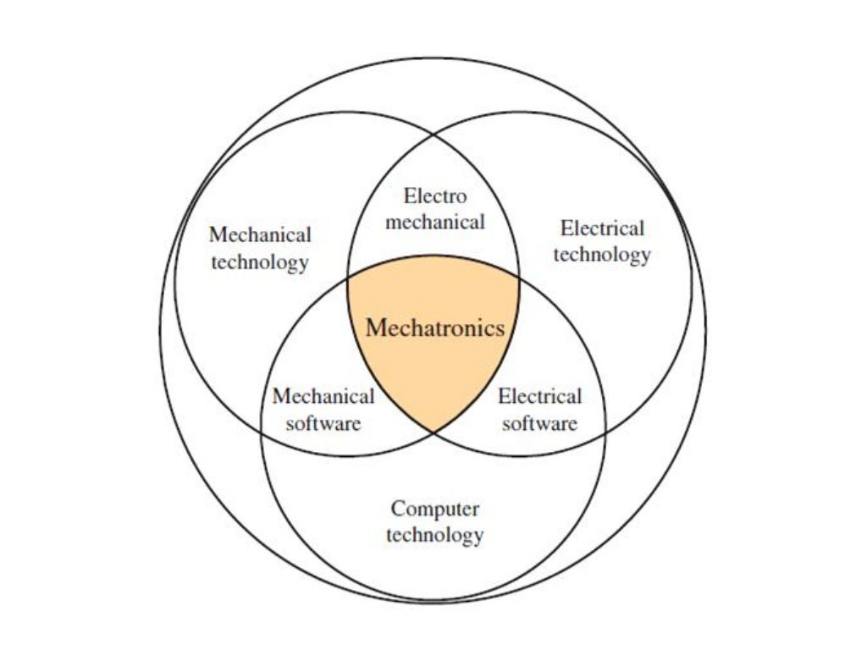

Slide 5
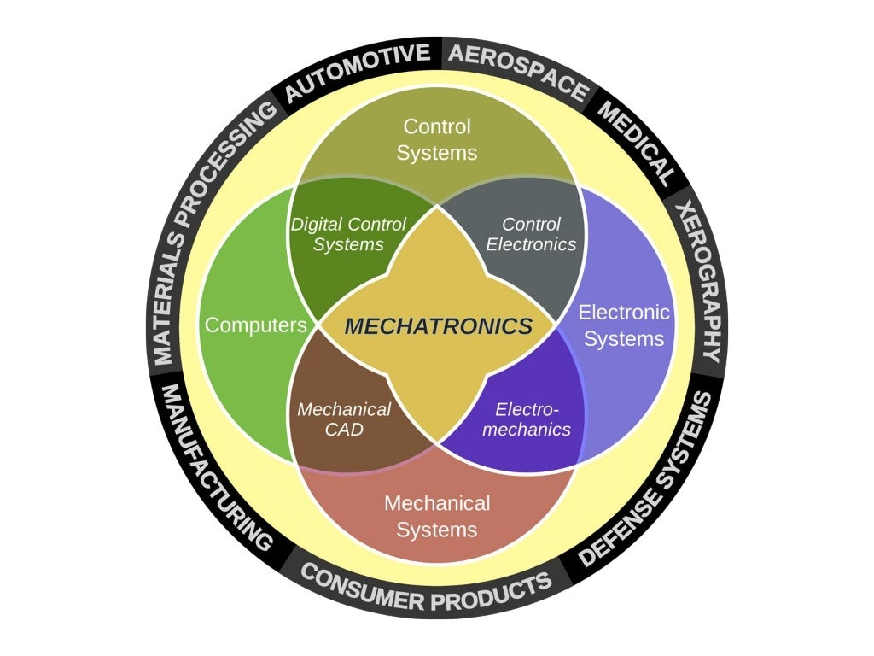

Slide 8
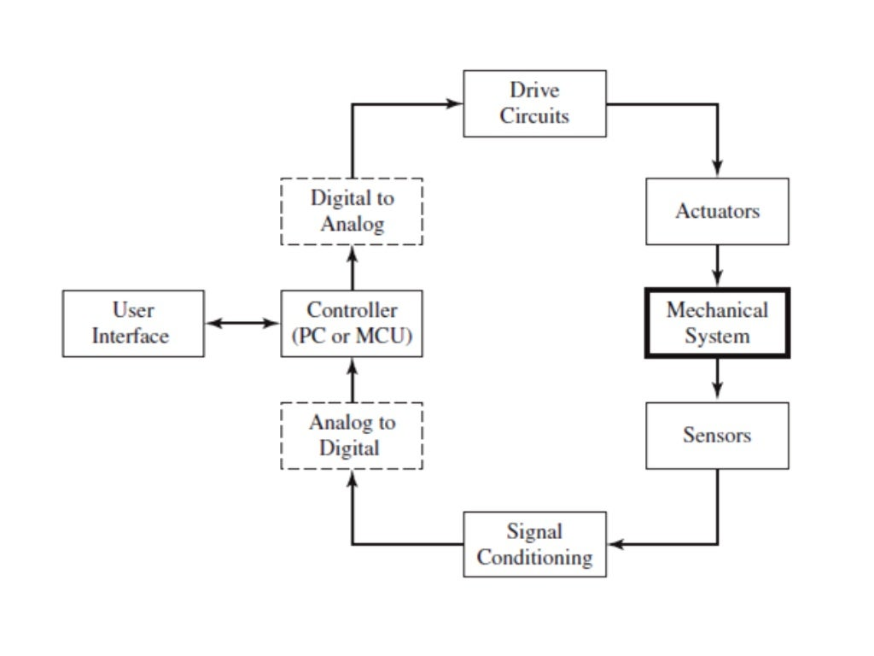

Slide 12
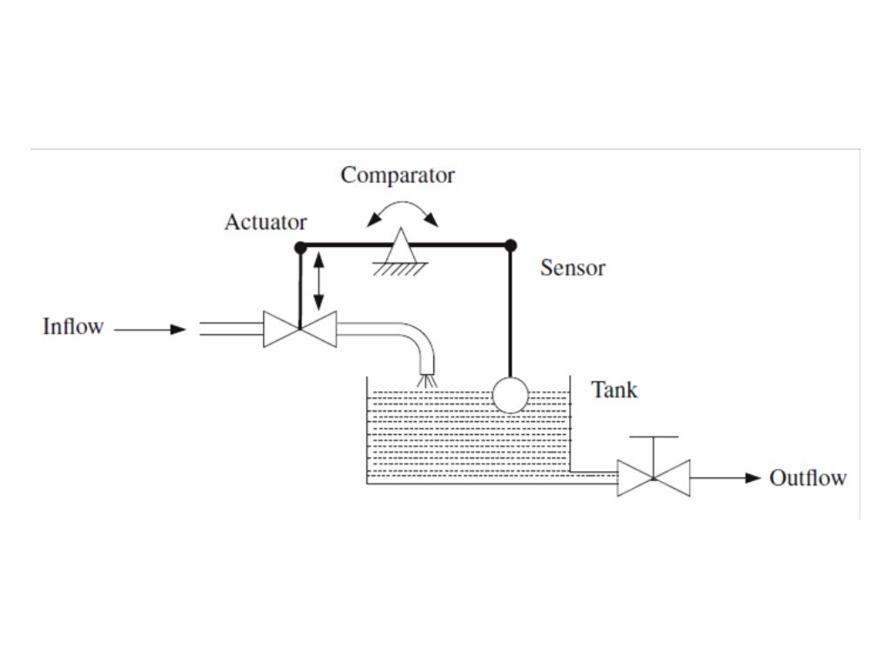

Slide 16
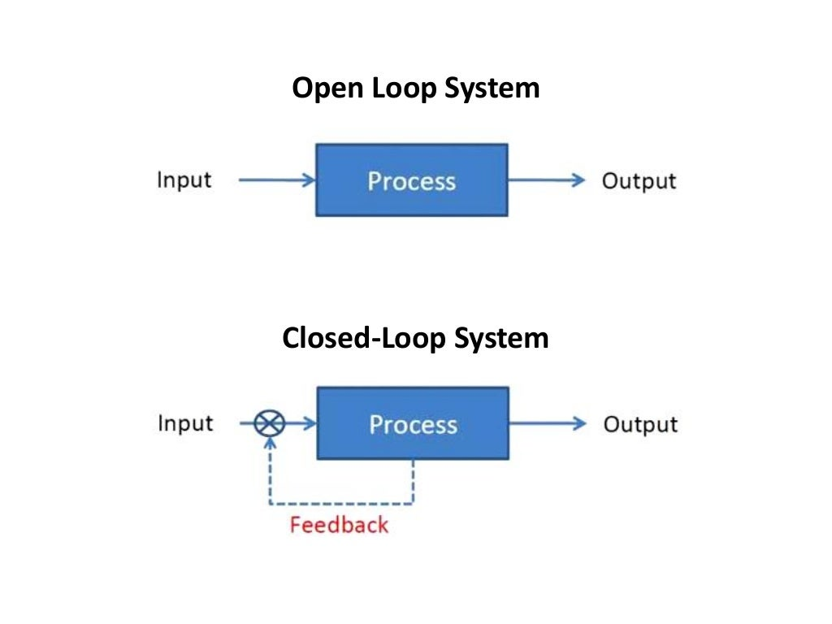

Slide 20
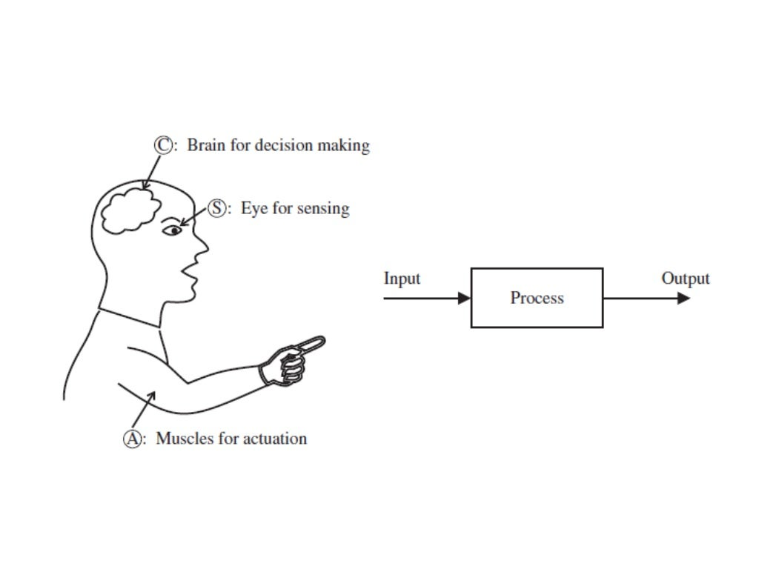

Slide 21
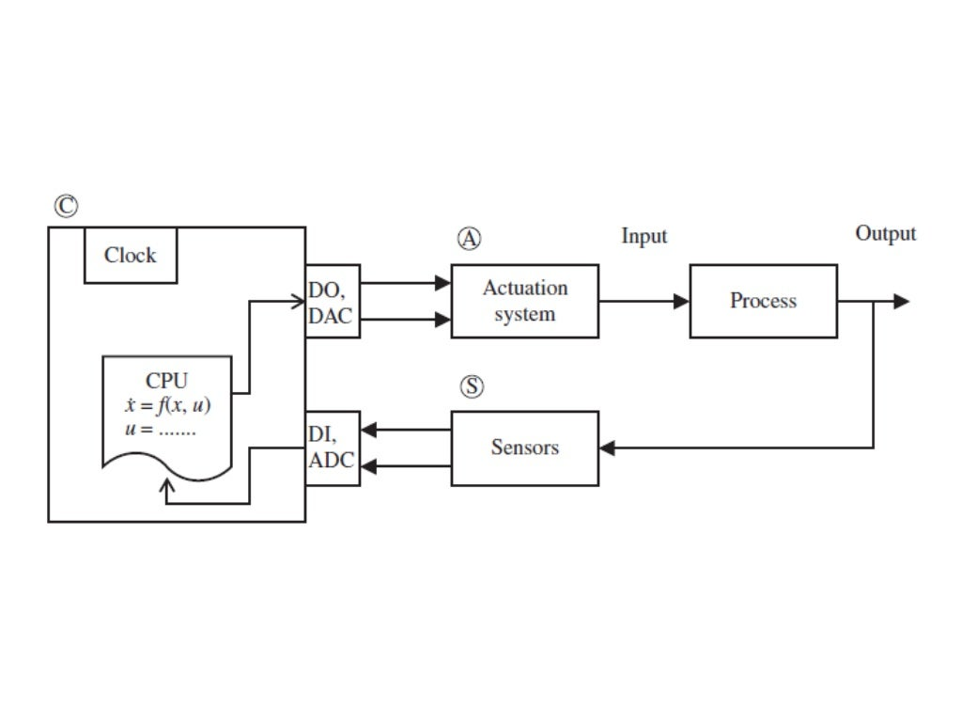

Slide 22
